Slide 1

Final Project Presentation
Deep Learning 2021
Team B -1
Amaury Chenain, Malo de Boisredon, & Côme de Germay

Slide 2
Deep Learning 2021
Team B -1
Agenda:
Project Description
Training Time
Classifier with a Cross Entropy Loss
Label Smoothing
Regression with a L1Loss
Predicting Aleatoric Uncertainty

Slide 3
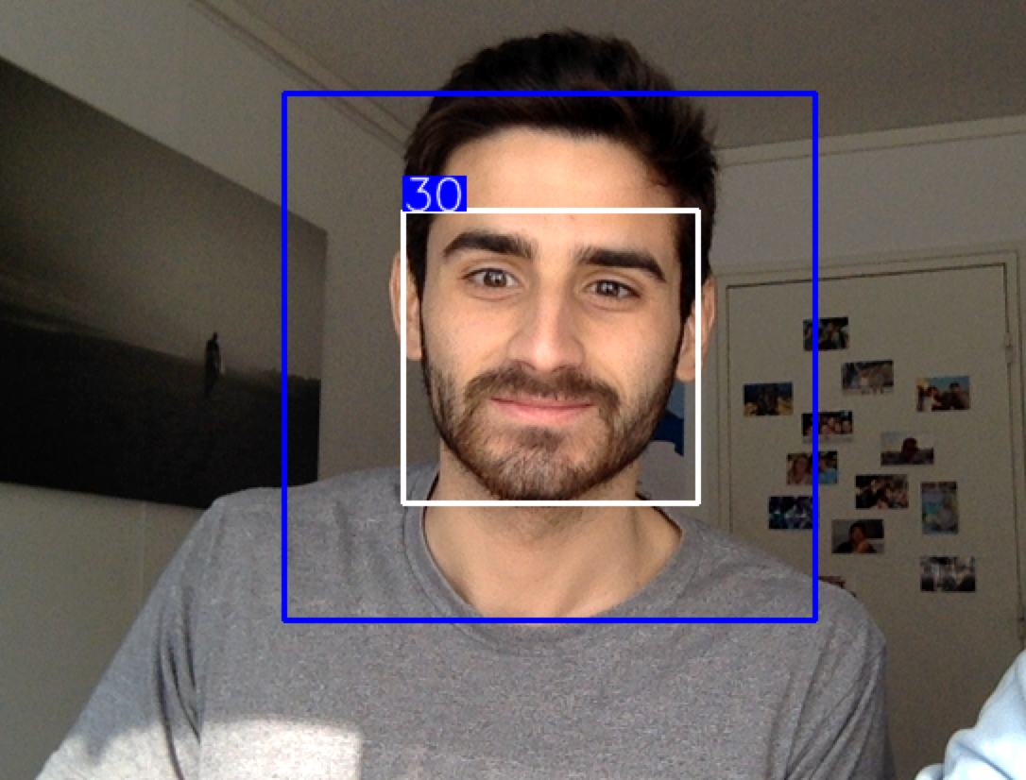
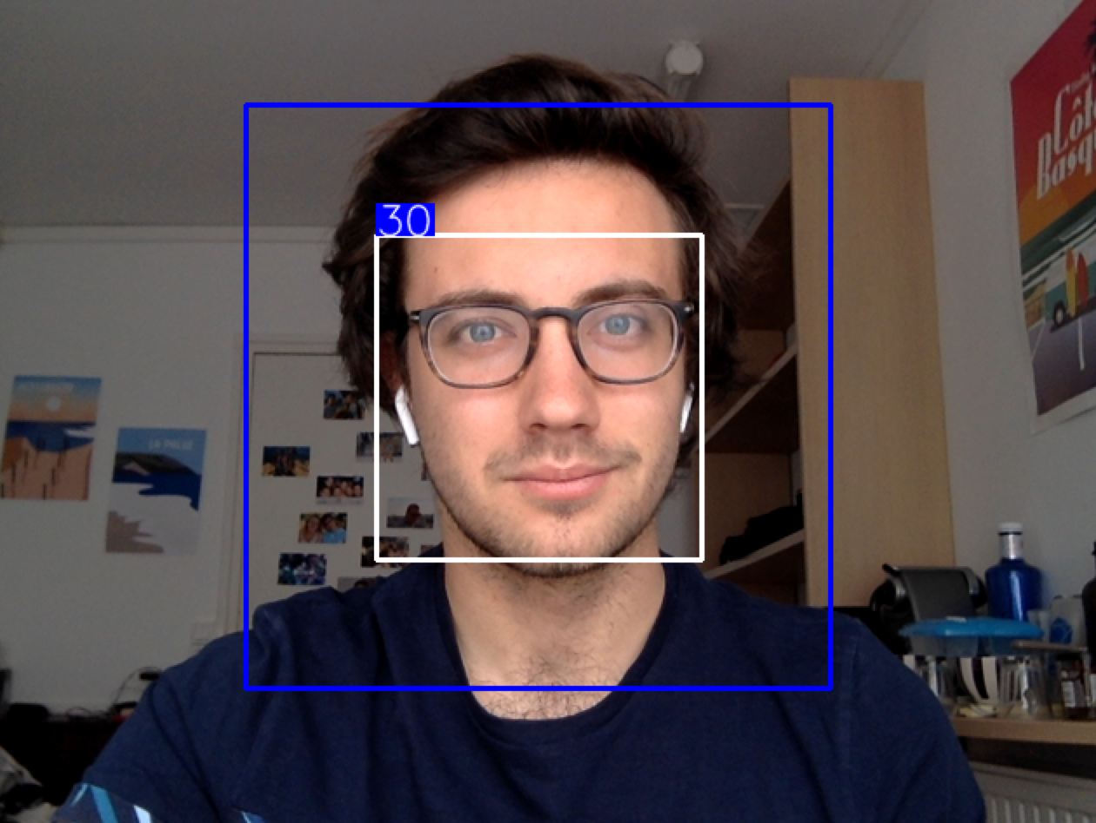
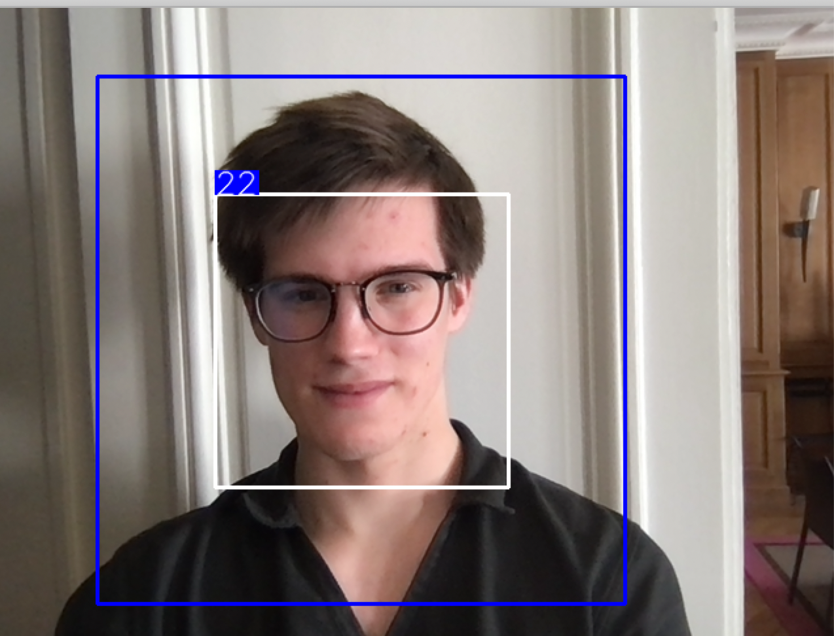
Deep Learning 2021
Team B -1
Project Description:
Design a deep learning model to predict the age of a person from a photograph

Slide 4
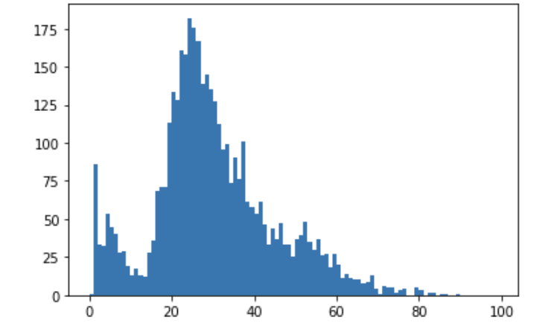
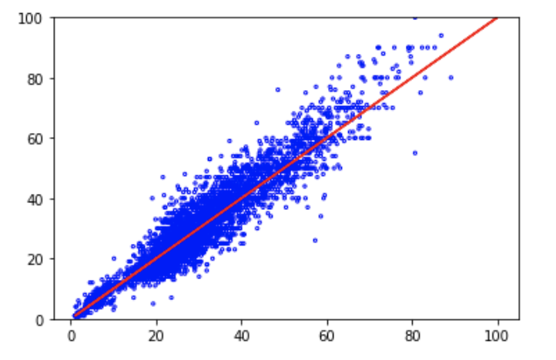
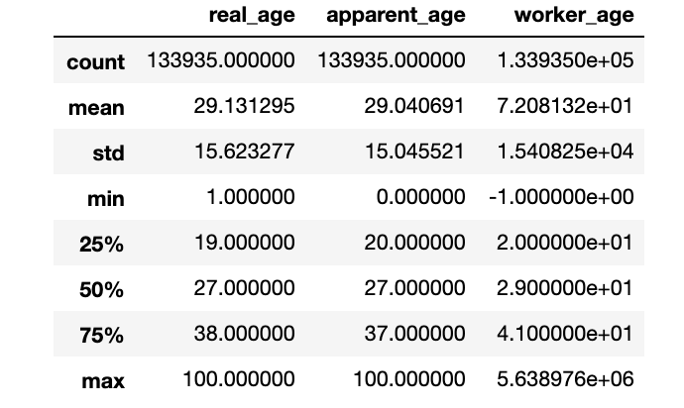
Deep Learning 2021
Team B -1
Project Description (2):
Highly imbalanced dataset centered around 29yo
We aimed to reduce the age bias by not by increasing the data samples but instead by improving the current model
Distribution analysis of the the train data set (54% of the full dataset)

Slide 5
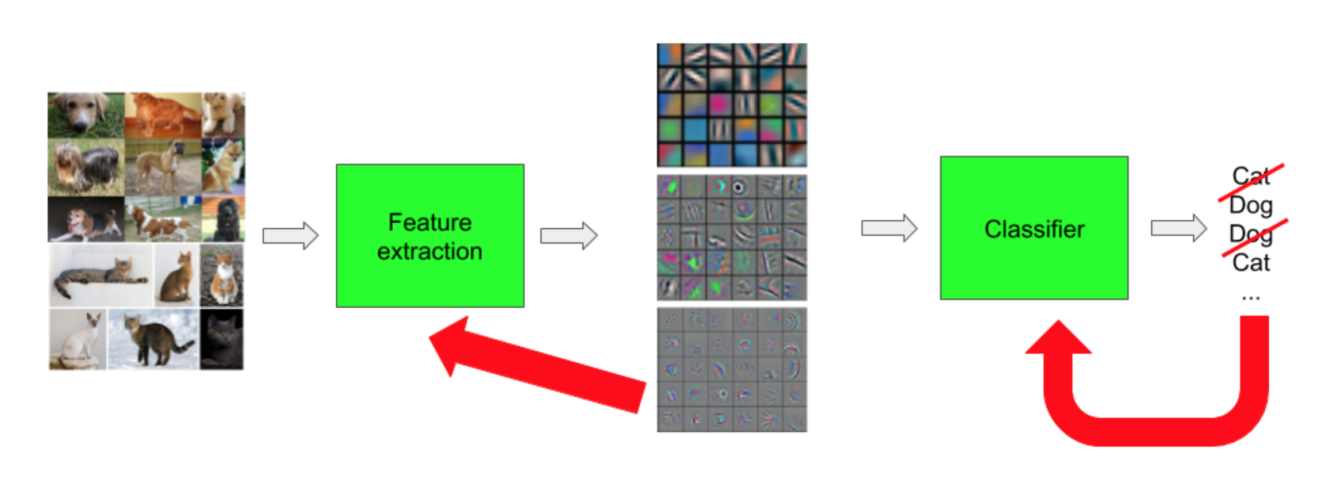
Deep Learning 2021
Team B -1
Training time
Large dataset and very deep network
Impossible to train for a regular cpu
Precompute features with a pretrained resnet
Train classifiers only on these features
Pretrained Resnet
Custom classifiers we actually trained

Slide 6
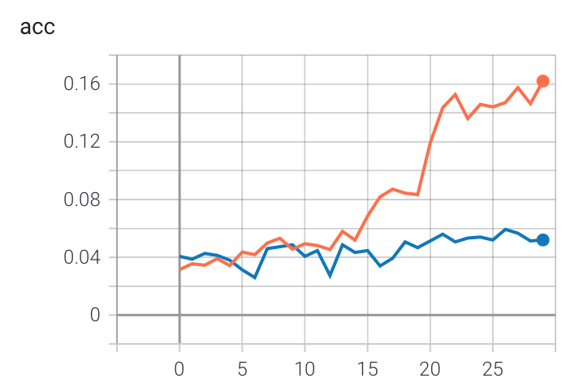
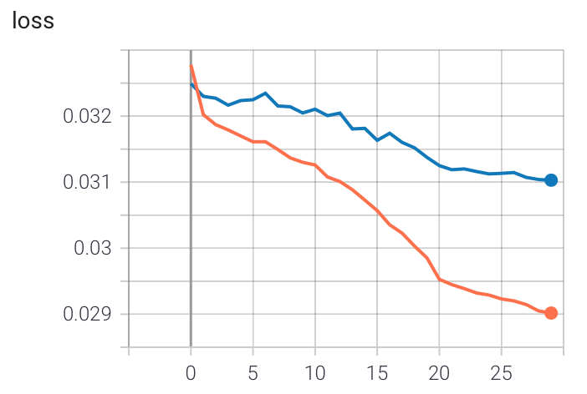
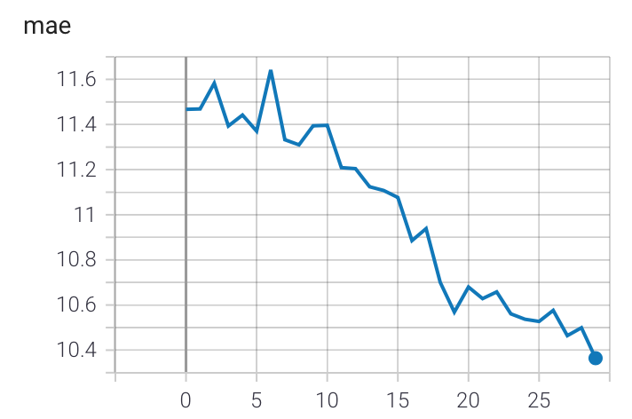
Deep Learning 2021
Team B -1
Classifier with a Cross Entropy Loss
Simple multi layer classifier trained with a cross entropy loss
Only maximises the probability of the exact age
Overfitting because it does not take into account the similarities between close classes

Slide 7
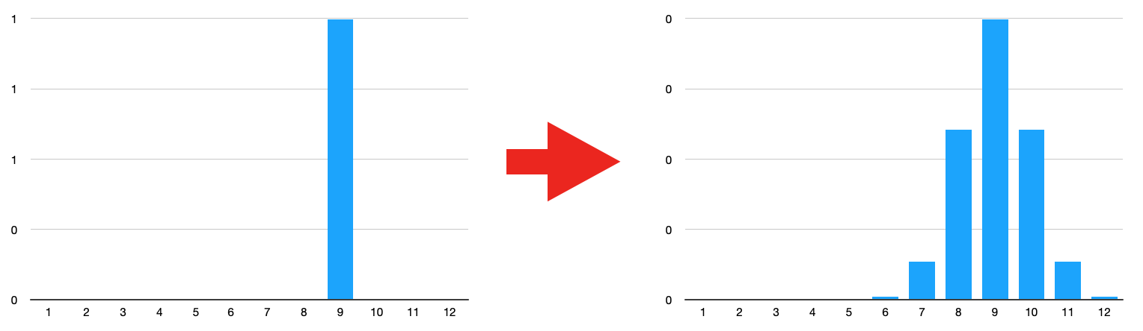
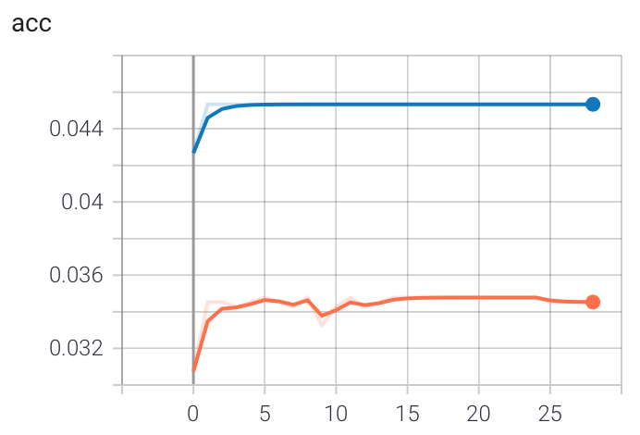
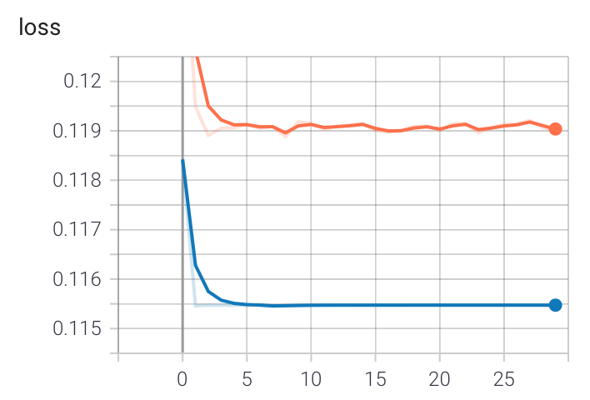
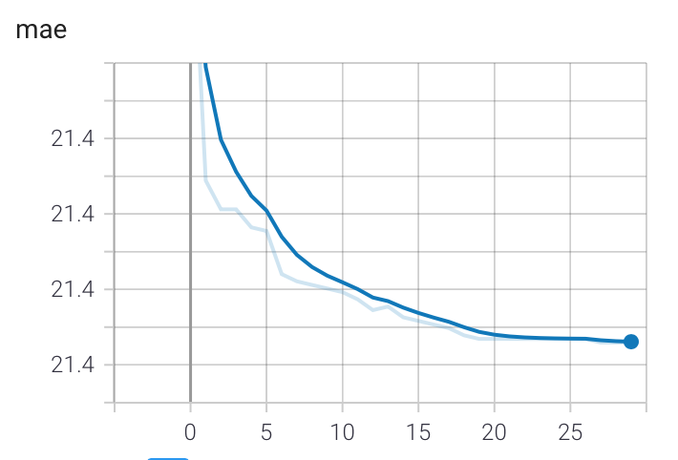
Deep Learning 2021
Team B -1
Label Smoothing
“smoothed” one hot vector
KL divergence
Gain in stability loss in accuracy
One Hot Vector
Smoothed Target Label

Slide 8
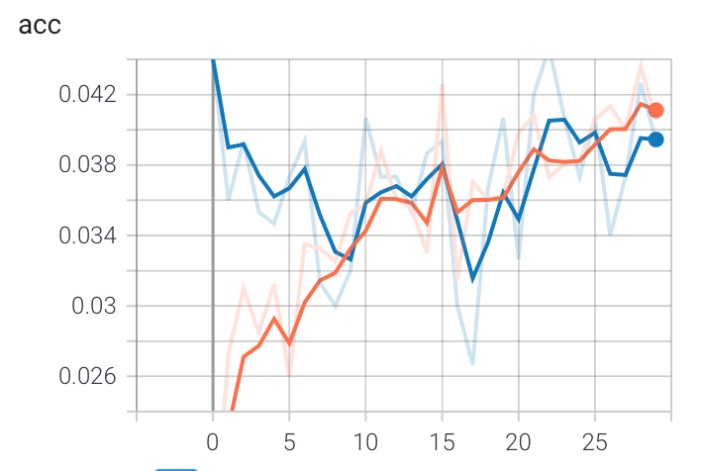
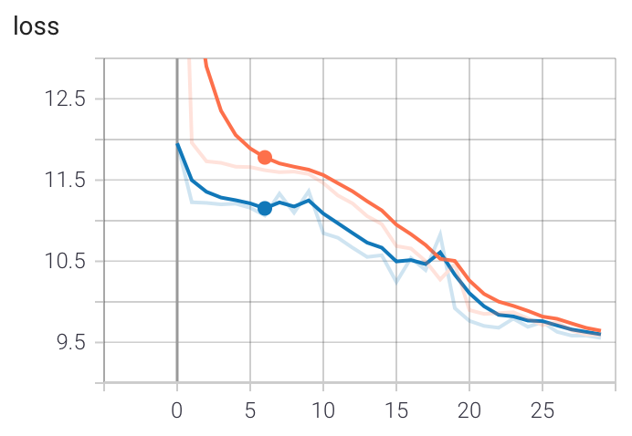
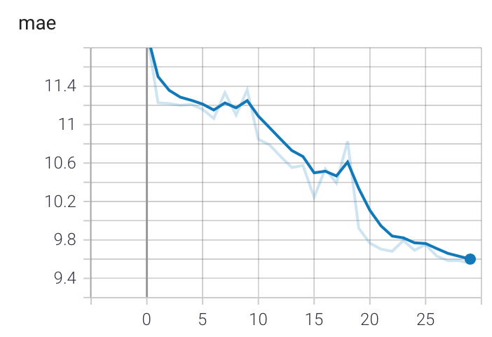
Deep Learning 2021
Team B -1
Regression with a L1 Loss:
Added a Regressor after the Precomputed features with a pretrained resnet
Model predicts one output instead of N classes outputted by the classifier
Improved MAE (compared to the classifier’s) due to the fact that Loss penalize error differently in the regression case

Slide 9
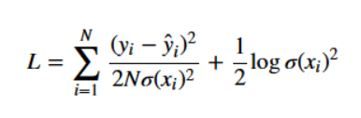
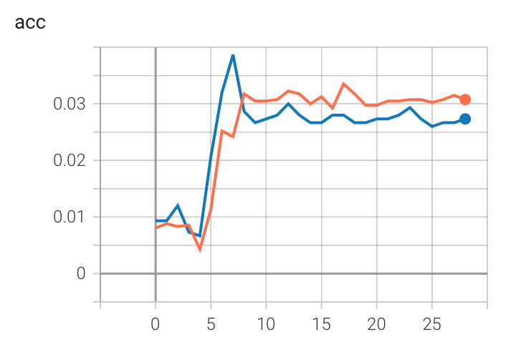
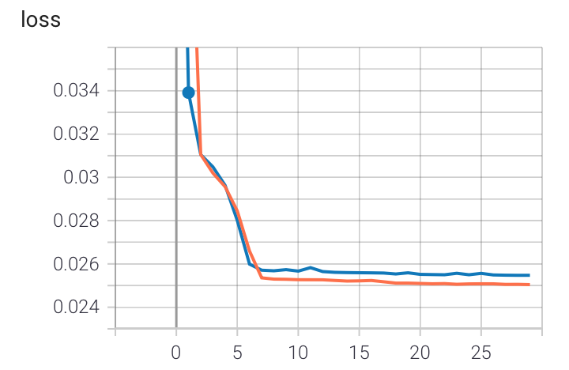
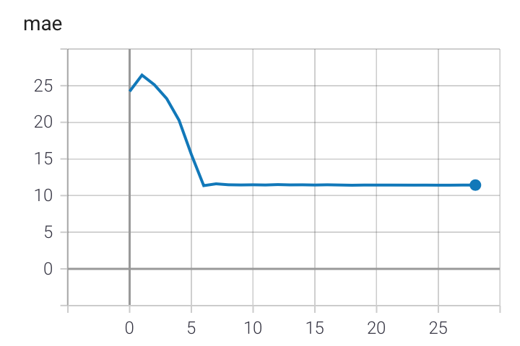
Deep Learning 2021
Team B -1
Predicting Aleatoric Uncertainty
Heteroscedastic uncertainty depends on the input data and therefore can be predicted as a model output
By including aleatoric uncertainty in the loss function, the model will make predictions with less confidence for data that is noisy.

Slide 10
Deep Learning 2021
Team B -1
References:
Dimitris Popoulos, How to Use Label Smoothing for Regularization, https://pub.towardsai.net/how-to-use-label-smoothing-for-regularization-aa349f7f1dbb, 22/03/2020.
Michek Kana, Uncertainty in Deep Learning. How to measure? https://towardsdatascience.com/my-deep-learning-model-says-sorry-i-dont-know-the-answer-that-s-absolutely-ok-50ffa562cb0b, 26/04/2020.
Jacob Reinhold, Knowing known unknowns with deep neural networks, https://towardsdatascience.com/knowing-known-unknowns-with-deep-neural-networks-caac1c4c1f5d, 21/06/2020.
Wanshun Wong, What is Label Smoothing, https://towardsdatascience.com/what-is-label-smoothing-108debd7ef06, 17/12/2019.
Alex Kendall and Yarin Gal, What uncertainties do we need in Bayesian deep learning for computer vision?, 05/10/2017

